Slide 1


<LIN>
<17/12/2024>

Slide 2

Outline
Executive Summary
Introduction
Methodology
Results
Conclusion
Appendix

Slide 3
Executive Summary
Summary of methodologies
The research aims to identify the factors contributing to a successful rocket landing. To achieve this, the following methodologies were employed:
Data Collection:
Utilized the SpaceX REST API and web scraping techniques to gather data.
Data Wrangling:
Processed the data to create a success/failure outcome variable.
Data Exploration:
Used data visualization techniques to explore the data, focusing on factors such as payload, launch site, flight number, and yearly trends.
Data Analysis:
Analyzed the data using SQL to calculate key statistics, including total payload, payload range for successful launches, and the total number of successful and failed outcomes.
Launch Site Analysis:
Investigated success rates of different launch sites and their proximity to geographical markers.
Data Visualization:
Visualized the launch sites with the highest success rates and the successful payload ranges.
Predictive Modeling:
Developed models to predict landing outcomes using logistic regression, support vector machine (SVM), decision tree, and K-nearest neighbor (KNN) algorithms.

Slide 4
Summary of all results
Exploratory Data Analysis
Improvement in Launch Success:
Launch success rates have increased over time.
Top Performing Launch Site:
KSC LC-39A has the highest success rate among all landing sites.
Orbit Success Rates:
Orbits ES-L1, GEO, HEO, and SSO boast a 100% success rate.
Executive Summary
Visualization/Analytics:
Most launch sites are situated near the equator and are close to coastal areas.
Predictive Analytics
Model Performance:
All models showed similar performance on the test set.
The decision tree model slightly outperformed the others.

Slide 5
Introduction
Project background and context
SpaceX advertises Falcon 9 rocket launches on its website at a cost of 62 million dollars, while other providers charge over 165 million dollars. This significant cost difference is mainly because SpaceX can reuse the first stage. Therefore, if we can predict whether the first stage will successfully land, we can estimate the launch cost. This information can help other companies make more competitive bids when competing against SpaceX for rocket launches.

Slide 6

Section 1

Slide 7
Methodology
Data collection methodology:
Request to the SpaceX API
Clean the requested data
Web scraping
Perform data wrangling
The dataset includes various cases where the booster did not land successfully, such as failed landings due to accidents. Specific outcomes are categorized as follows: True Ocean indicates a successful landing in the ocean, while False Ocean indicates a failed ocean landing; True RTLS means a successful landing on a ground pad, and False RTLS indicates a failed ground pad landing; True ASDS signifies a successful landing on a drone ship, while False ASDS represents a failed landing on a drone ship. In this lab, these outcomes will be converted into training labels, where 1 represents a successful landing and 0 represents an unsuccessful one.
Perform exploratory data analysis (EDA) using visualization and SQL
Perform interactive visual analytics using Folium and Plotly Dash

Slide 8
Perform predictive analysis using classification models
Convert the "Class" column into a NumPy array.
Standardize the data using StandardScaler, applying both fit and transform.
Split the data using train_test_split.
Create a GridSearchCV object with cv=10 for parameter optimization.
Apply GridSearchCV on various algorithms:
Logistic Regression (LogisticRegression())
Support Vector Machine (SVC())
Decision Tree (DecisionTreeClassifier())
K-Nearest Neighbor (KNeighborsClassifier()).
Calculate the accuracy on the test data using .score() for all models.
Evaluate the confusion matrix for each model.
Identify the best-performing model using metrics such as Jaccard Score, F1 Score, and Accuracy.

Slide 9
Data Collection
Request rocket launch data from the SpaceX API.
Decode the API response using .json() and convert it into a dataframe using .json_normalize().
Use custom functions to request information about the launches from the SpaceX API.
Create a dictionary from the retrieved data.
Convert the dictionary into a dataframe.
Filter the dataframe to include only Falcon 9 launches.
Replace missing values in the Payload Mass column with the calculated mean value.
Export the cleaned data to a CSV file.
Request Falcon 9 launch data from Wikipedia.
Create a BeautifulSoup object by parsing the HTML response.
Extract the column names from the HTML table header.
Parse and collect the data from the HTML tables.
Create a dictionary from the collected data.
Convert the dictionary into a dataframe.
Export the dataframe to a CSV file.

Slide 10
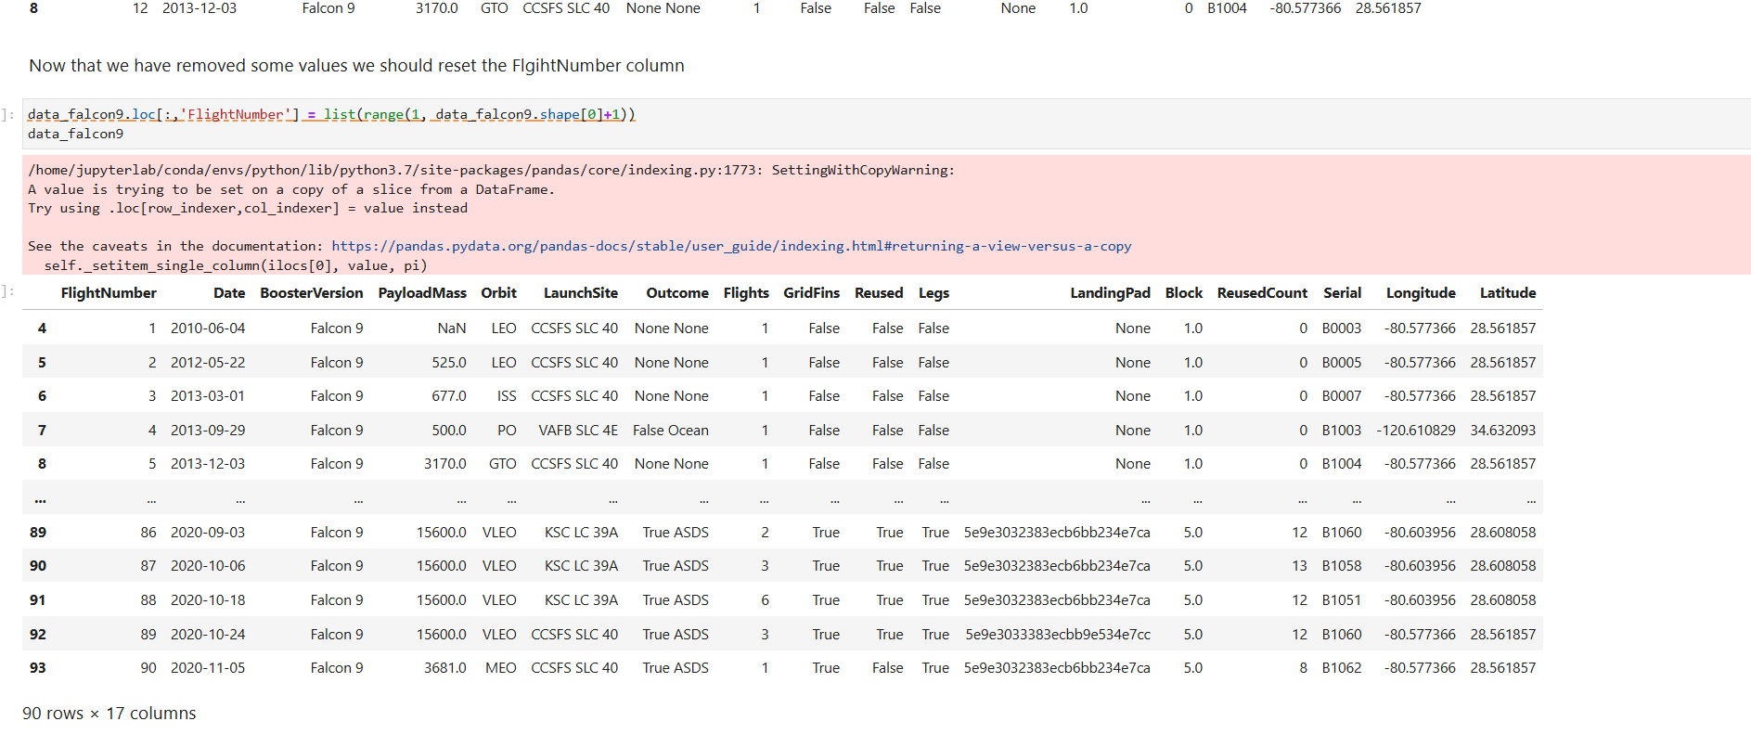
Data Collection –SpaceX API
https://github.com/linlinorange/myXrepo/blob/d903bce2e8bf18e14c27ca0a954d92b283d05136/jupyter-labs-spacex-data-collection-api%20(1).ipynb

Slide 11
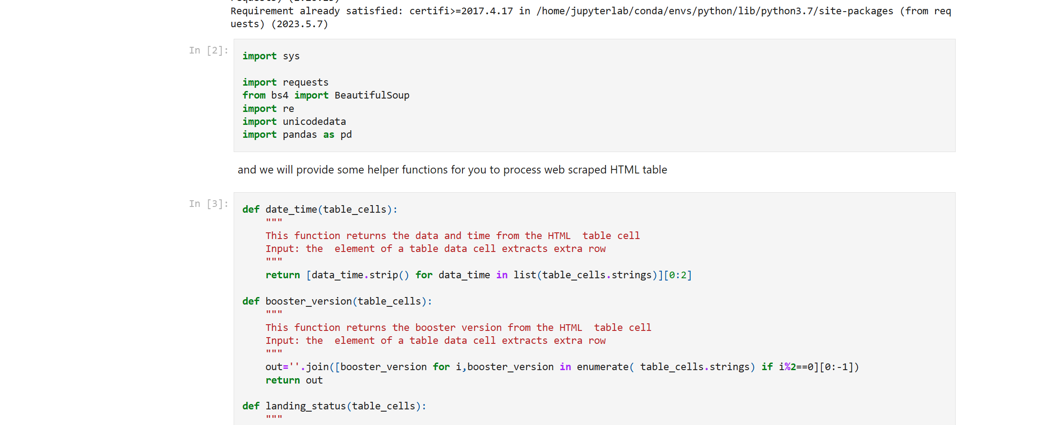
Data Collection - Scraping
https://github.com/linlinorange/myXrepo/blob/d903bce2e8bf18e14c27ca0a954d92b283d05136/jupyter-labs-webscraping.ipynb

Slide 12
Data Wrangling
Steps:
Perform Exploratory Data Analysis (EDA) and define data labels.
Calculate the following:
Number of launches for each site.
Frequency of each orbit type and its occurrence.
Frequency of mission outcomes per orbit type.
Create a binary landing outcome column (dependent variable):
False Ocean: Represents an unsuccessful landing in a specific region of the ocean.
True RTLS: Indicates a successful landing on a ground pad.
False RTLS: Represents an unsuccessful landing on a ground pad.
True ASDS: Indicates a successful landing on a drone ship.
False ASDS: Represents an unsuccessful landing on a drone ship.
Convert the outcomes into binary values:
1 for a successful landing.
0 for an unsuccessful landing.
Export the processed data to a CSV file.
Landing Outcome Details:
Landing outcomes were not always successful.
True Ocean: Represents a successful landing in a specific region of the ocean.

Slide 13
EDA with Data Visualization
Charts:
Flight Number vs. Payload: Visualize the relationship between the flight number and the payload.
Flight Number vs. Launch Site: Show how different flight numbers correspond to various launch sites.
Payload Mass (kg) vs. Launch Site: Examine the relationship between payload mass and launch site.
Payload Mass (kg) vs. Orbit Type: Analyze how payload mass varies across different orbit types.
EDA with Visualization:
Scatter Plots: Use scatter plots to visualize the relationships between variables. These relationships could be valuable for machine learning if a clear correlation exists.
Bar Charts: Compare discrete categories using bar charts. Bar charts effectively highlight relationships between categories and their associated measured values.

Slide 14
EDA with SQL
Display:
List the unique launch sites.
Show 5 records where the launch site name starts with 'CCA'.
Calculate the total payload mass carried by boosters launched by NASA (CRS).
Determine the average payload mass carried by the F9 v1.1 booster version.
List:
Provide the date of the first successful landing on a ground pad.
Identify boosters that successfully landed on a drone ship and have a payload mass between 4,000 and 6,000 kg.
Count the total number of successful and failed missions.
List the booster versions that carried the maximum payload.
Show failed landing outcomes on the drone ship, including the booster version and launch site for the months in 2015.
Count the landing outcomes between 2010-06-04 and 2017-03-20, sorted in descending order.
https://github.com/linlinorange/myXrepo/blob/d903bce2e8bf18e14c27ca0a954d92b283d05136/jupyter-labs-eda-sql-coursera_sqllite.ipynb

Slide 15
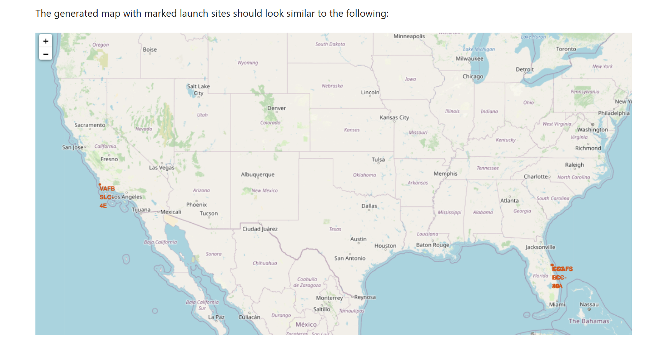
Build an Interactive Map with Folium
https://github.com/linlinorange/myXrepo/blob/d903bce2e8bf18e14c27ca0a954d92b283d05136/lab_jupyter_launch_site_location.ipynb

Slide 16
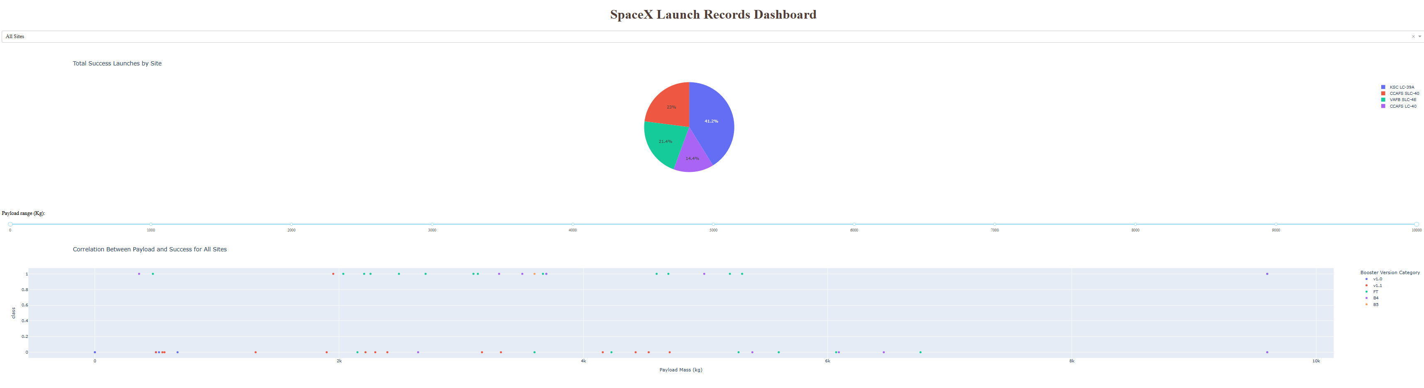
Build a Dashboard with Plotly Dash
https://github.com/linlinorange/myXrepo/blob/d903bce2e8bf18e14c27ca0a954d92b283d05136/spacex_dash_app.py

Slide 17
Predictive Analysis (Classification)
Convert the "Class" column into a NumPy array.
Standardize the data using StandardScaler, applying both the fit and transform steps.
Split the data using train_test_split.
Create a GridSearchCV object with cv=10 for parameter optimization.
Apply GridSearchCV on various algorithms:
Logistic Regression (LogisticRegression())
Support Vector Machine (SVC())
Decision Tree (DecisionTreeClassifier())
K-Nearest Neighbor (KNeighborsClassifier()).
Calculate the accuracy on the test data using .score() for each model.
Evaluate the confusion matrix for all models.
Determine the best model based on Jaccard Score, F1 Score, and Accuracy.

Slide 18
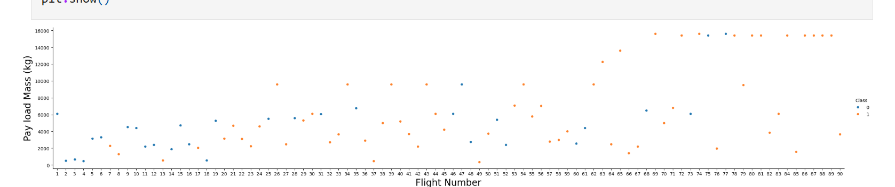
Results

Slide 19
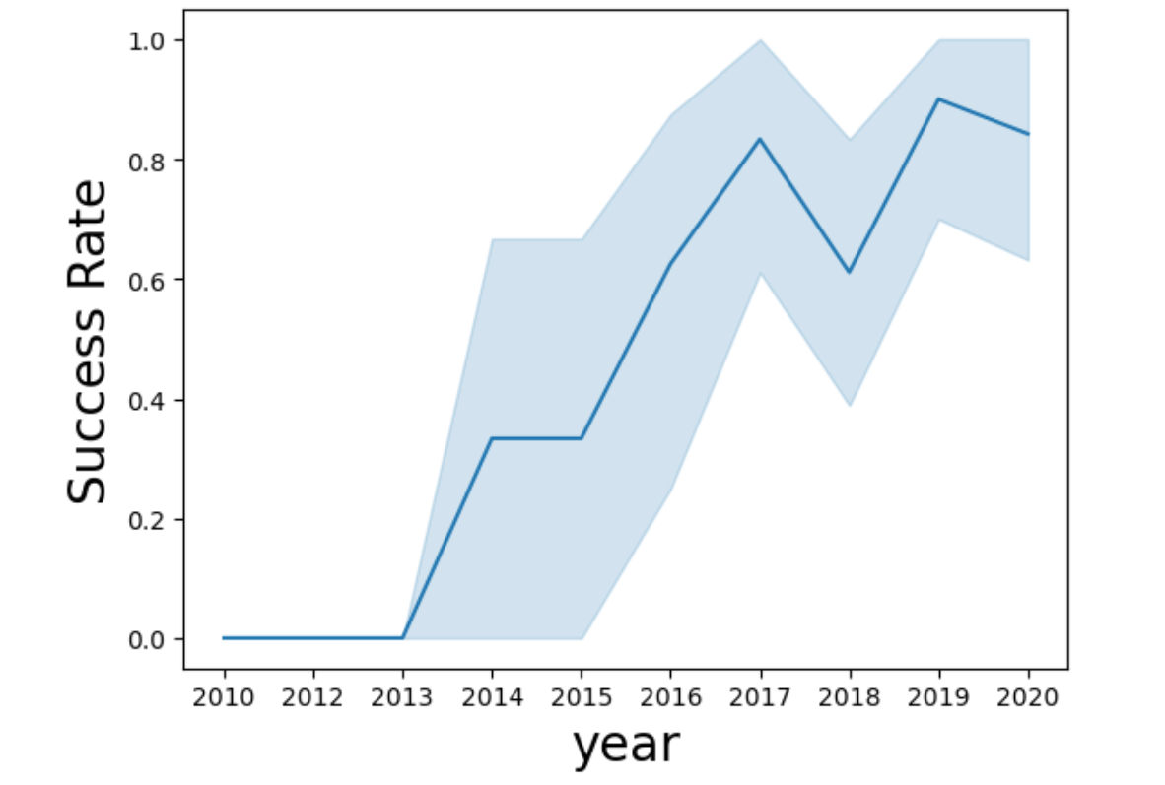

Slide 20
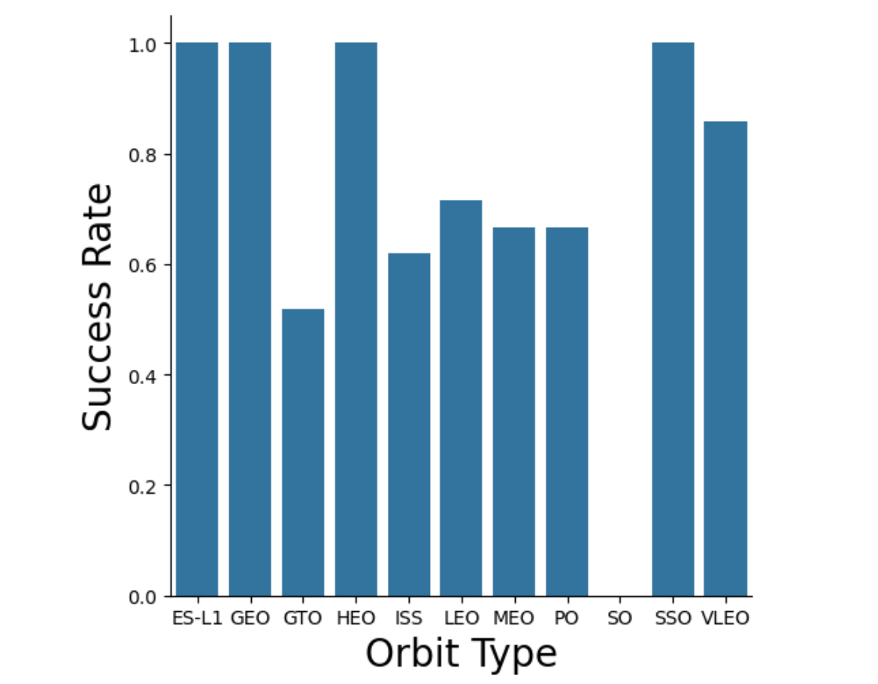

Slide 21

Section 2

Slide 22
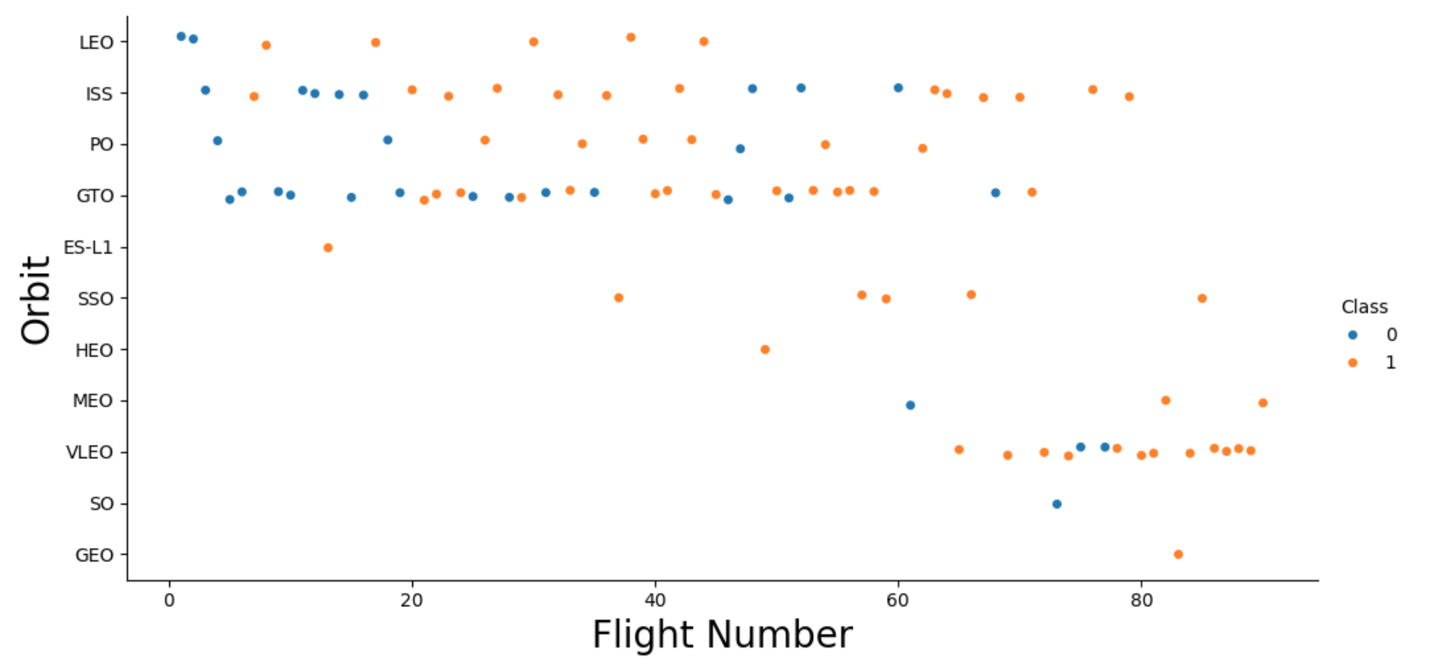
Flight Number vs. Launch Site

Slide 23
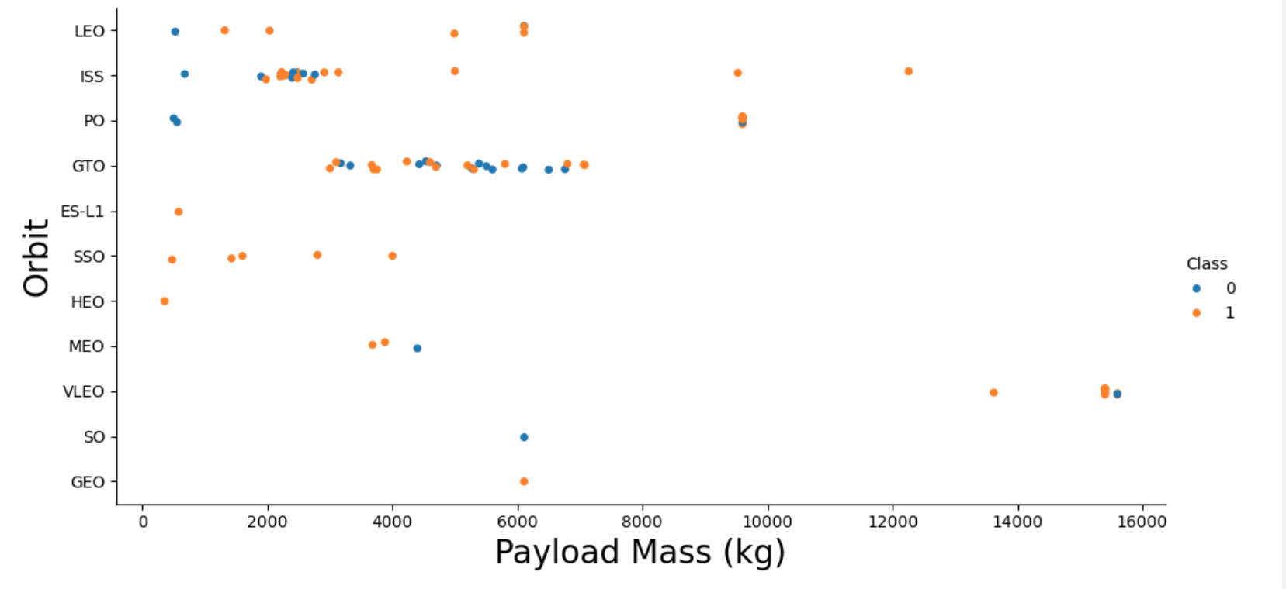
Payload vs. Launch Site

Slide 24
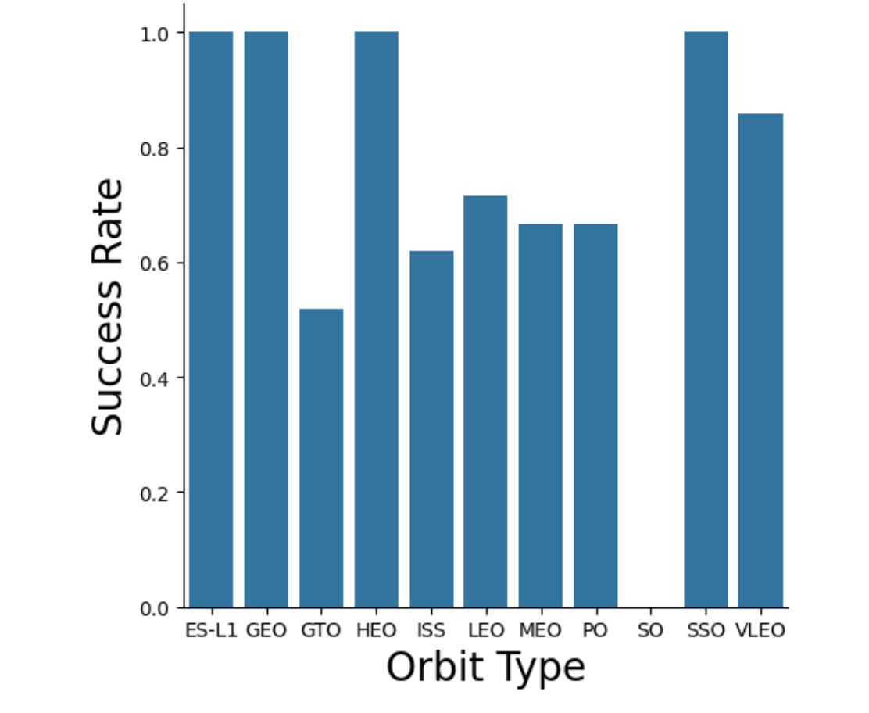
Success Rate vs. Orbit Type

Slide 25
Flight Number vs. Orbit Type
Show a scatter point of Flight number vs. Orbit type
Show the screenshot of the scatter plot with explanations

Slide 26
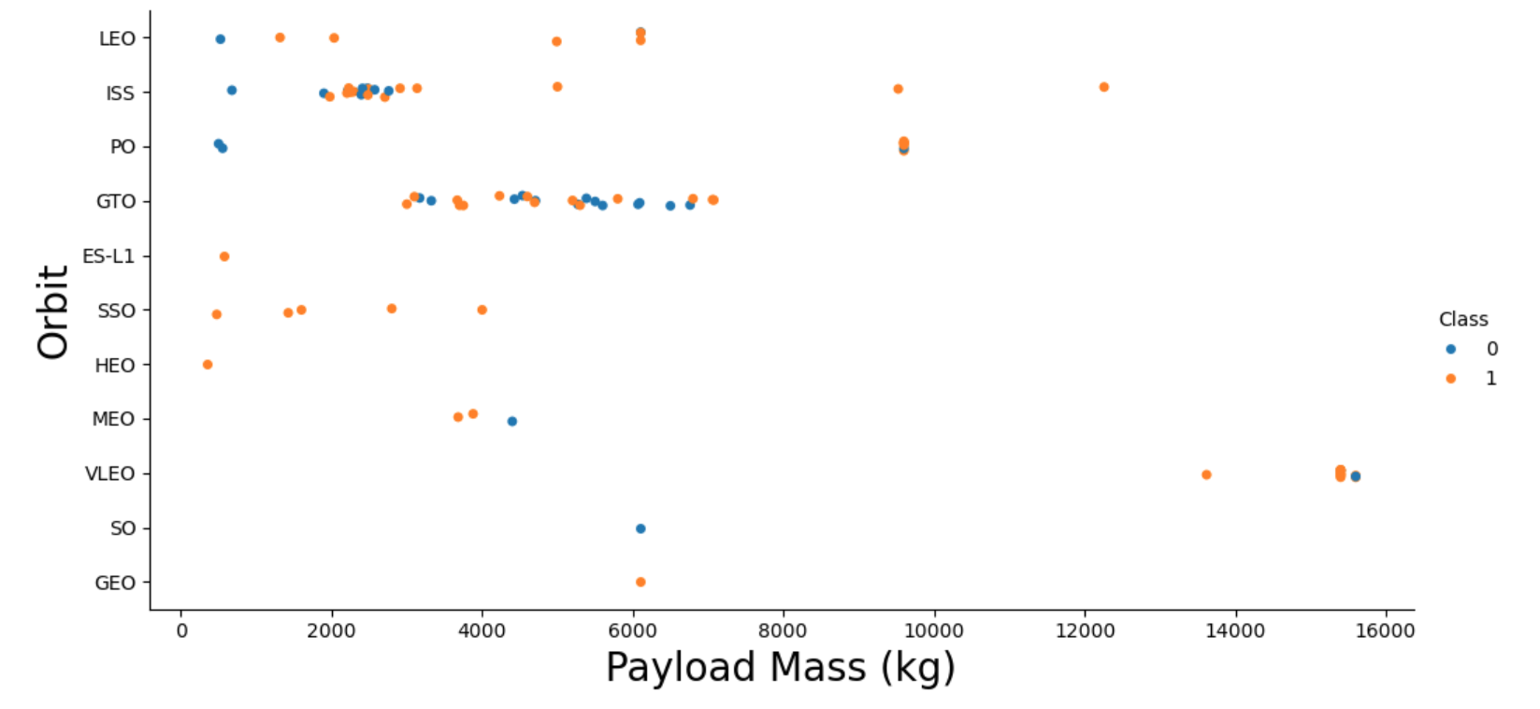
Payload vs. Orbit Type

Slide 27
Launch Success Yearly Trend

Slide 28
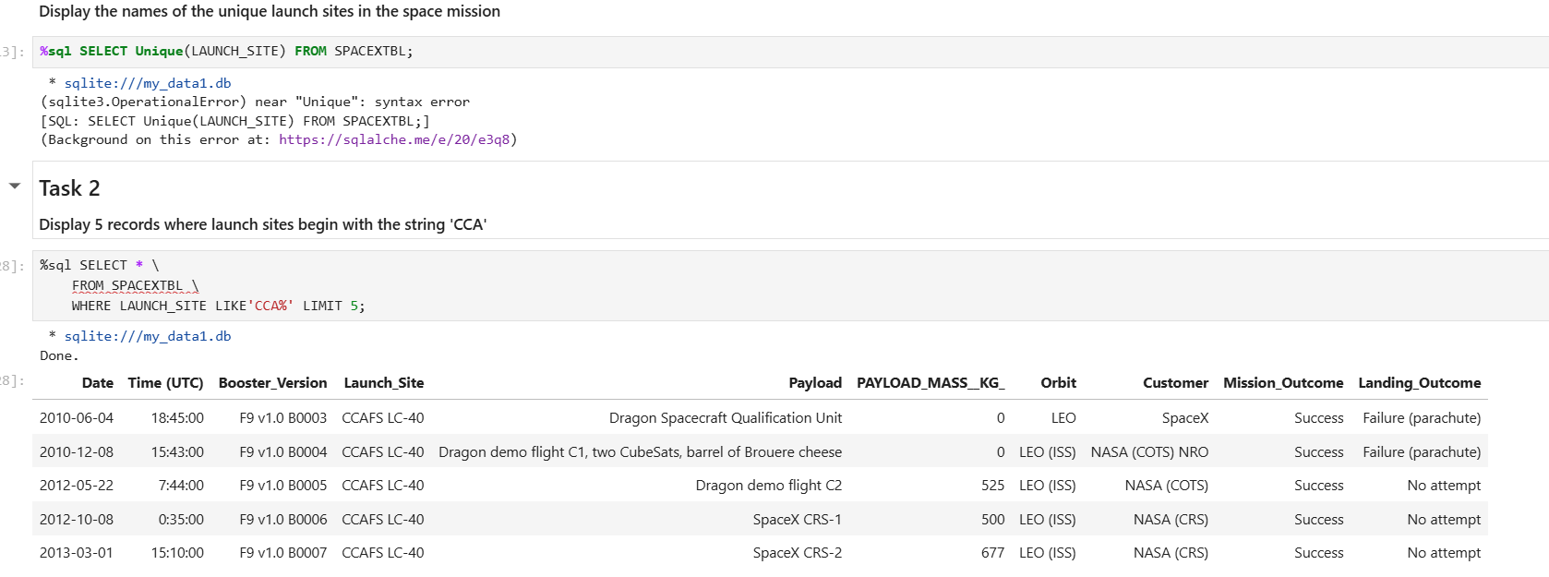
All Launch Site Names
Launch Site Names Begin with 'CCA'

Slide 29
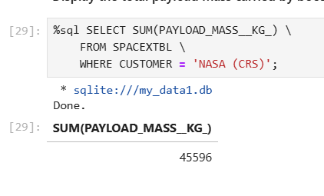
Total Payload Mass

Slide 30
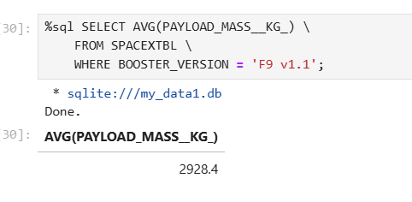
Average Payload Mass by F9 v1.1

Slide 31
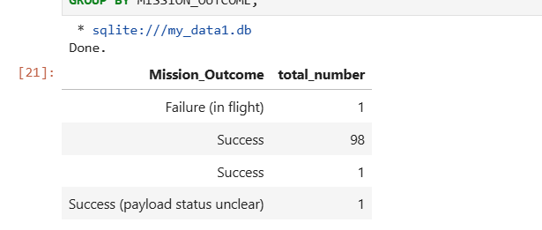
Total Number of Successful and Failure Mission Outcomes
Calculate the total number of successful and failure mission outcomes
Present your query result with a short explanation here

Slide 32
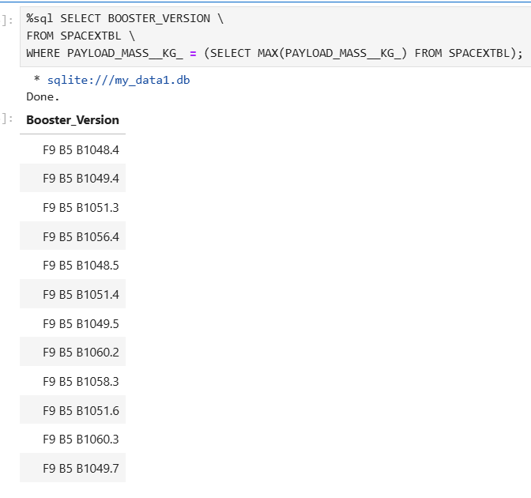
Boosters Carried Maximum Payload

Slide 33
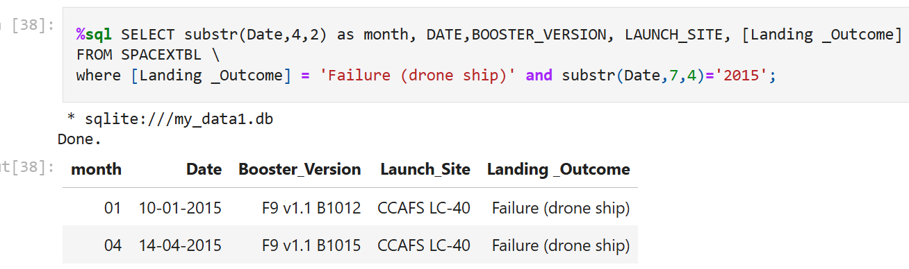
2015 Launch Records

Slide 34
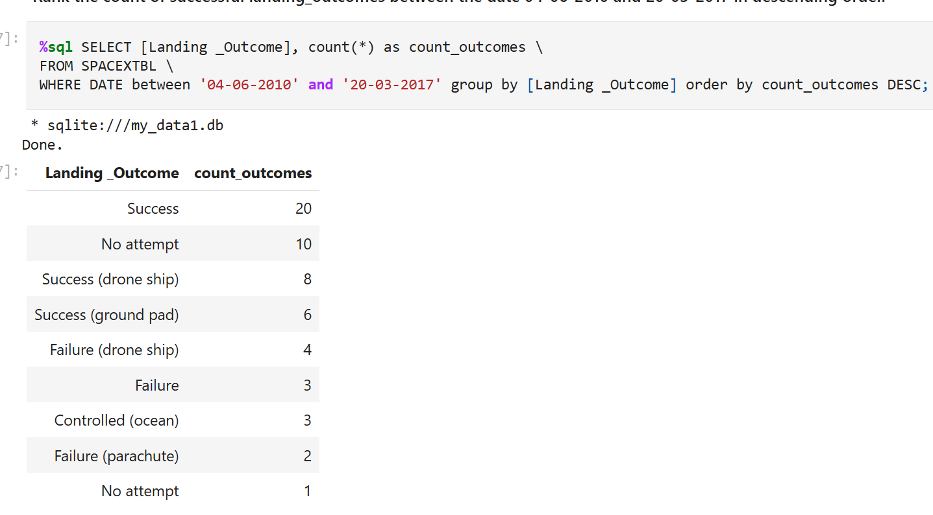
Rank Landing Outcomes Between 2010-06-04 and 2017-03-20

Slide 35

Section 3

Slide 36
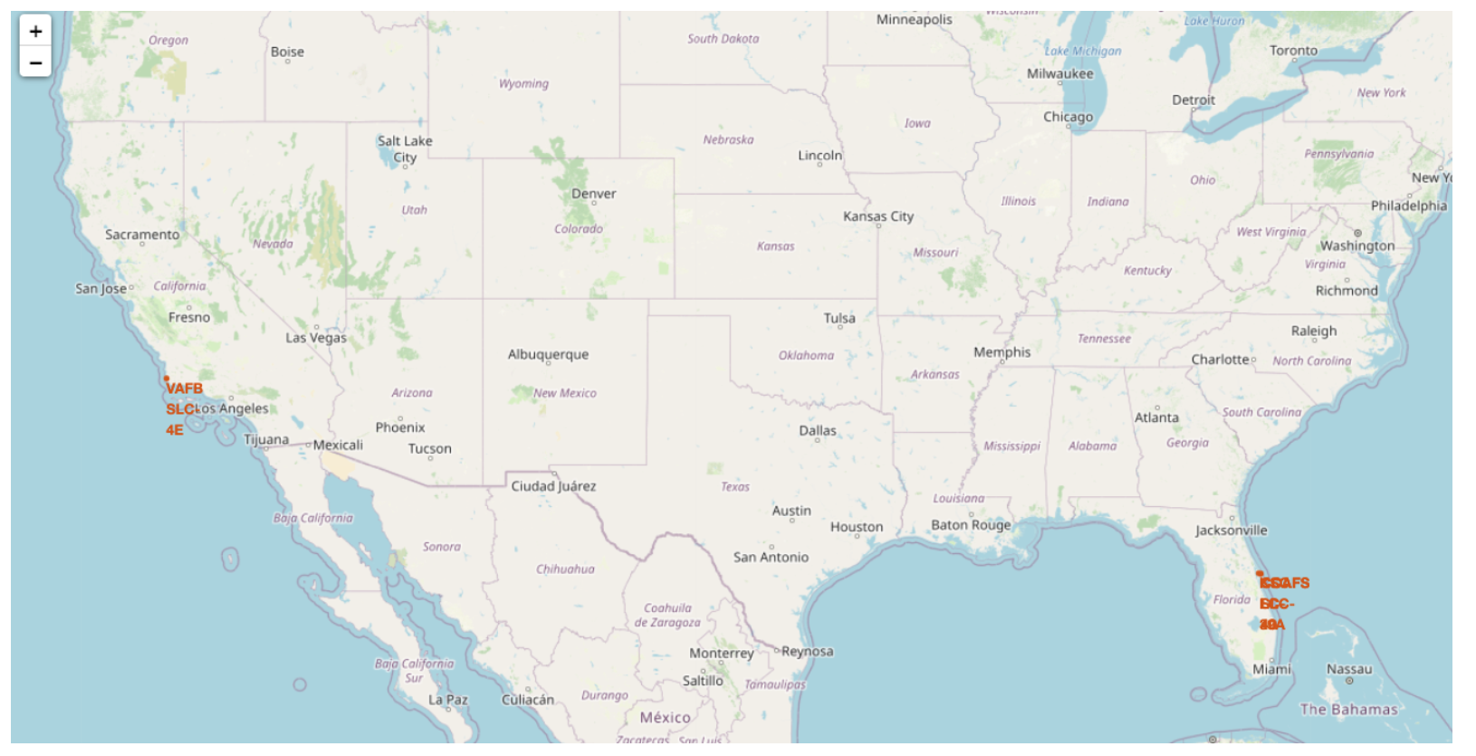
launch sites

Slide 37
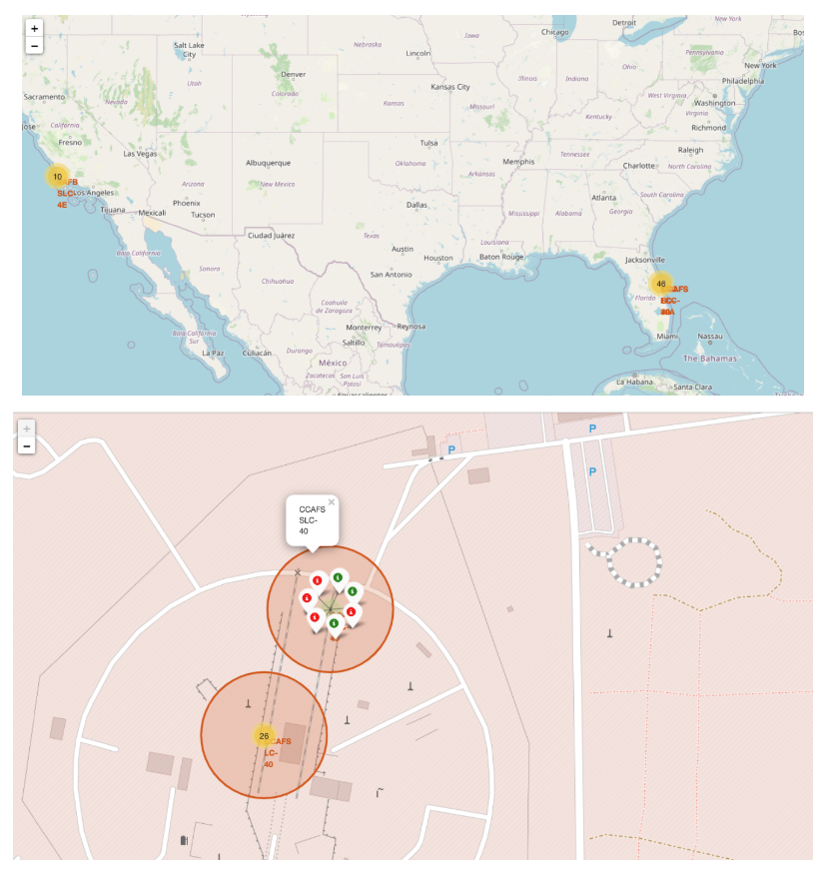
launch sites 2

Slide 38
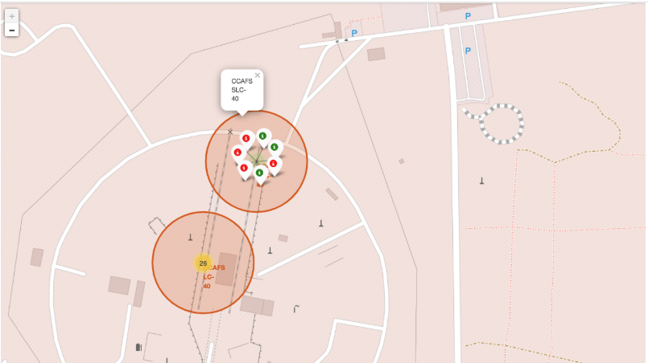
Launch Outcomes

Slide 39
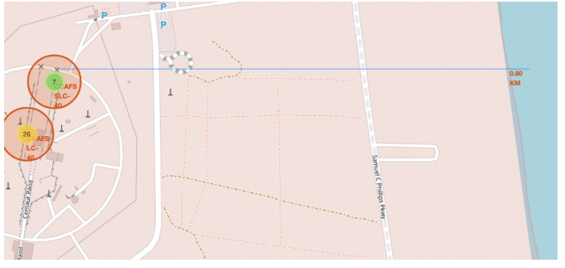

Slide 40

Section 4

Slide 41
Launch Success by Site

Slide 42

Section 5

Slide 43
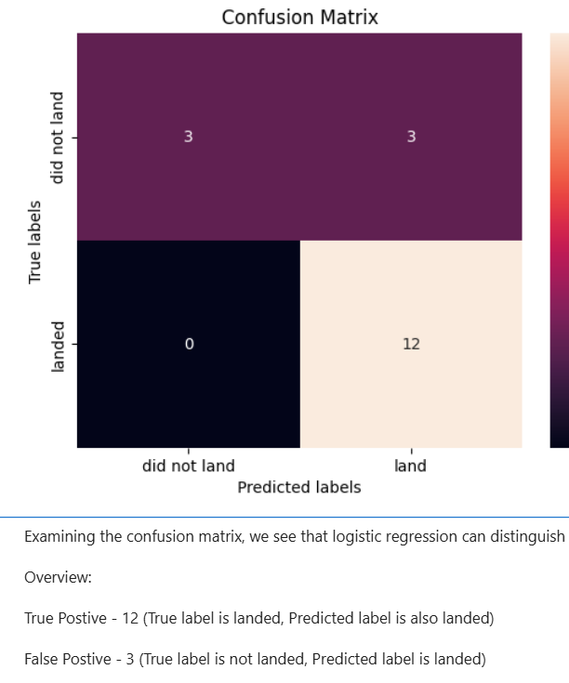
Classification Accuracy

Slide 44
Conclusions
Research Findings:
Model Performance: The models performed similarly on the test set, with the decision tree model slightly outperforming the others.
Equator: Most launch sites are located near the equator, which provides a natural boost due to the Earth's rotational speed. This helps reduce the need for extra fuel and boosters, saving costs.
Coast: All launch sites are situated close to the coast.
Launch Success: The success rate of launches has increased over time.
KSC LC-39A: This site has the highest success rate among all launch sites, with a 100% success rate for launches carrying less than 5,500 kg.
Orbits: ES-L1, GEO, HEO, and SSO orbits each have a 100% success rate.
Payload Mass: At all launch sites, a higher payload mass (kg) correlates with a higher success rate.

Slide 45


